Slide 1

Emerging Acquisitions Workflows:
Print DDA

Slide 2
The Proposition
Whether it’s to overhaul a traditional approval plan, or to replicate the success of e-book acquisition programs, more libraries are implementing print Demand Driven Acquisition (DDA) programs.
This document describes a print DDA process that is easy to implement using existing Alma features, with no technical expertise required!

Slide 3
Overview
Create DDA profile with book provider
Patron makes purchase request in Primo
Selector reviews request & orders book
Book provider fulfills the order
Receive book and alert the requestor
Load MARC records into Alma
Once you’ve created a DDA profile with the appropriate parameters (like price threshold and subject area), the provider will send a set of MARC records. Load records into Alma and create inventory with a special location and a unique call number like “On Demand.”

Slide 4
Overview
Create DDA profile with book provider
Patron makes purchase request in Primo
Selector reviews request & orders book
Book provider fulfills the order
Receive book and alert the requestor
Load MARC records into Alma
When the records are published to Primo, authorized patrons can create a purchase request from the discovery results using the metadata from the existing MARC record.

Slide 5
Overview
Create DDA profile with book provider
Patron makes purchase request in Primo
Selector reviews request & orders book
Book provider fulfills the order
Receive book and alert the requestor
Load MARC records into Alma
Selectors mediate the requests, accepting or rejecting them per local policies.
If the request is accepted the Selector can issue a Purchase Order Line, and the requestor is alerted that the title is on order.

Slide 6
Overview
Create DDA profile with book provider
Patron makes purchase request in Primo
Selector reviews request & orders book
Book provider fulfills the order
Receive book and alert the requestor
Load MARC records into Alma
Once the title has been received from the provider, the requestor is alerted that the title is at the library and/or is on hold for them.

Slide 7
Required Set-Up
Step | Where
Create DDA profile | Book provider platform
Create Import Profile | Alma (See: Record Import)
Assign Selector role to Alma staff member(s) | Alma (See: Managing User Roles)
“Unhide” the purchase request for patrons | Alma (See second note: Purchase Requests)
Define purchase request reject reasons | Alma (See: Configuring Purchase Request Reject Reasons)
Configure related letters | Alma (See: Configuring Alma Letters)

Slide 8
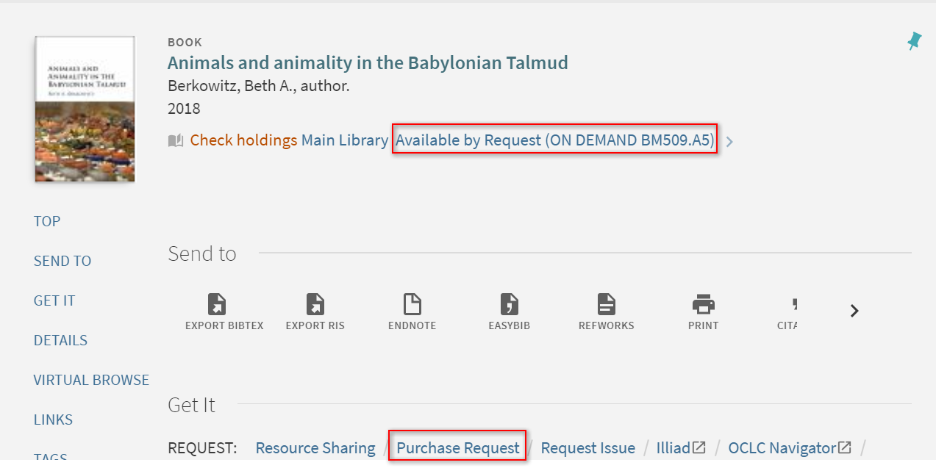
Primo Purchase Request

Slide 9
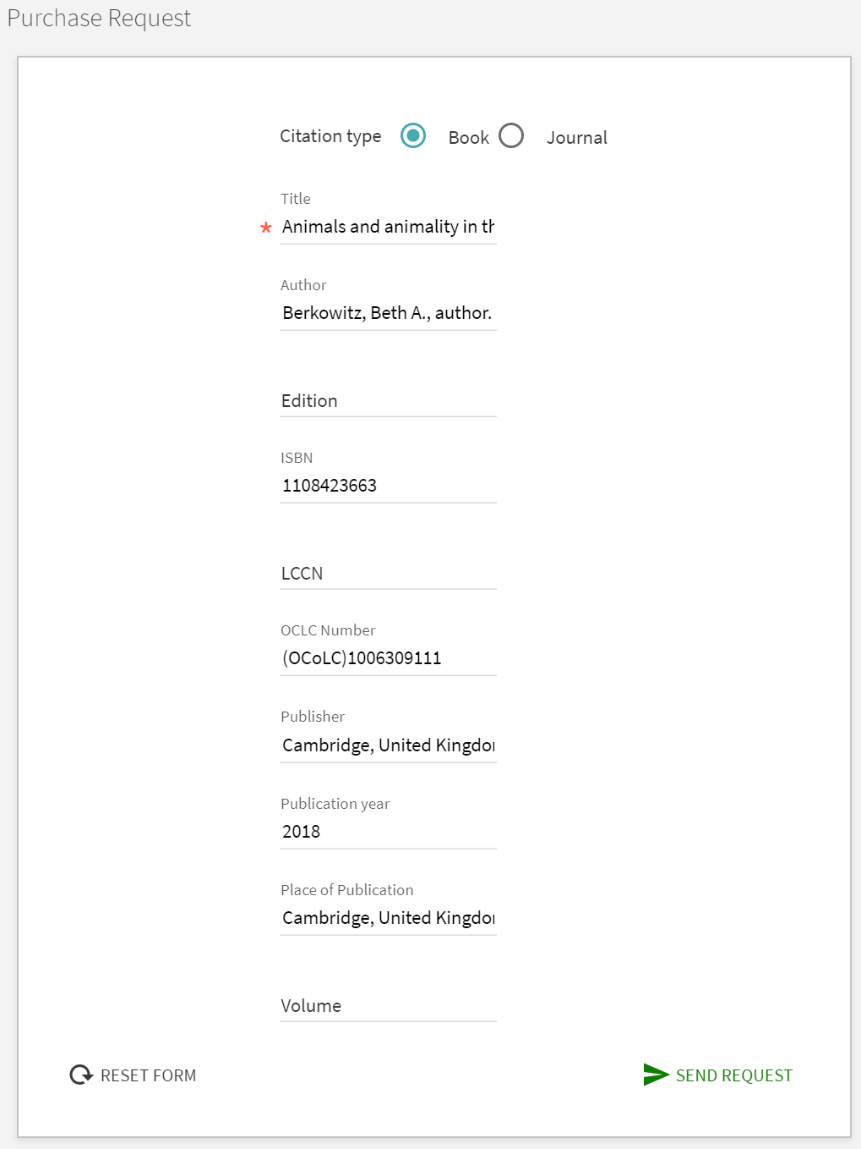
Primo Purchase Request
The purchase request is pre-populated
from the MARC record, which means
users have to do no data entry
and the quality of the metadata is
guaranteed.

Slide 10
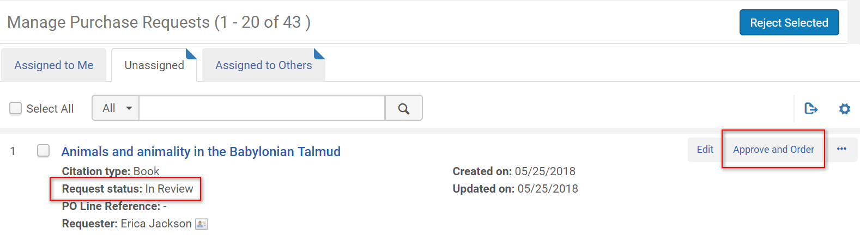
Selector Reviews Request

Slide 11
Purchase Request Handling Options
Clicking “Approve” will
  Create an order
  Send an email to the requester notifying him that the request has been created as an acquisitions order.
Clicking “Reject” will
  Change the status of the order to “Rejected”
  Send an email to the requester notifying him that the request has been rejected.
Click “Send Query to Requester” will
  Open an email form addressed to the requester and include the bibliographic details of the request
  Allow the staff user to enter a query and send it to the patron

Slide 12
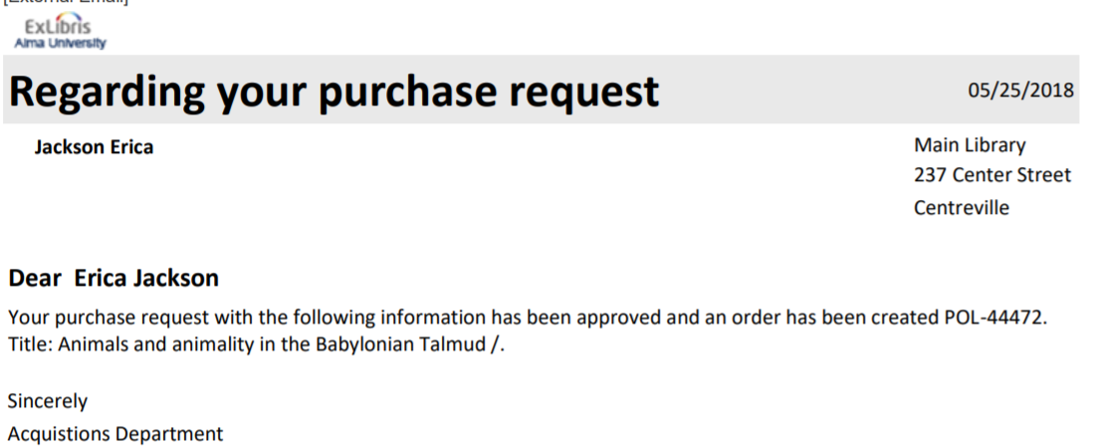
Requestor Receives Letter

Slide 13
Completing the Process
An acq staffer receives the physical book using standard Alma workflows
The requestor is alerted and, if configured, the book is placed on hold for them
An EDI invoice is processed for the purchase and the order is closed.
Remove records when necessary:
  Remove the print DDA inventory record after the purchased title arrives and has a “real” location & call number
  When the DDA project ends, remove the unpurchased titles’ records from the collection

Slide 14
Print DDA Benefits
Easy to implement with existing software—no APIs or development work required
“Just in time” purchases are made—more circulation anticipated than in “just in case” scenario
Library has ultimate control
  How much money may be spent
  Whether to approve/reject a request
  With whom to place the request
By using a print DDA-specific location or other tag, the library can market DDA titles for staff, faculty, and patrons
Alma Analytics can measure the usage, cost per usage, and participation in the program

